Slide 1
A Presentation
on
E-COMMERCE

Slide 2

Table of Contents
1.
E-Commerce overview
Definition of e-commerce
Brief history of e-commerce
2.
E-Commerce categories
Two major categories
Other categories
3.
Benefits of e-commerce
Benefits to organizations
Benefits to consumers
4.
Business applications
5.
Online shopping
6.
Interesting facts and figures
7.
Summary and Conclusion

Slide 3

E-Commerce Overview
Definition of E-Commerce
Brief History of E-Commerce
1

Slide 4

Definition of E-Commerce
E-Commerce or Electronic commerce is a process of buying, selling, transferring, or exchanging products, services, and/or information via electronic networks and computers

Slide 5
Definition of Commerce
The exchange of goods and services for money
Consists of:
Buyers - these are people with money who want to purchase a good or service.
Sellers - these are the people who offer goods and services to buyers.
Producers - these are the people who create the products and services that sellers offer to buyers.
5

Slide 6

Brief History of E-Commerce
1970s
E- commerce meant the facilitation of commercial transactions electronically, using technology such as Electronic Data Interchange (EDI) and Electronic Funds Transfer (EFT), allowing businesses to send commercial documents like purchase orders or invoices electronically.

Slide 7

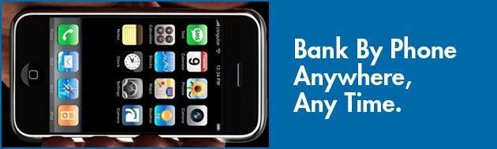
Brief History of E-Commerce (cont)..
1980s
The growth and acceptance of credit cards
Automated teller machines (ATM)
Telephone banking
Airline reservation system
2

Slide 8

Brief History of E-Commerce (cont)..
1990s
The Internet commercialized and users flocked to participate in the form of dot-coms, or Internet start-ups
Innovative applications ranging from online direct sales to e-learning experiences

Slide 9
Brief History of E-Commerce (cont)..
2000s
Many European and American business companies offered their services through the World Wide Web.
Since then, People began to associate a word “e- commerce”

Slide 10
Types of Commerce
 |  | Commerce
Electronic Commerce |  |  |  |  | Physical or Traditional Commerce
Internet Commerce

Business focused
e-commerce
Consumer focused e-commerce


Slide 11

Different types of E-Commerce
 | Business (organization) | Customer (individual)
Business (organization) | B2B (e.g TPN) | B2C (e.g Amazon)
Customer (individual) | C2B (e.g Priceline) | C2C (e.g eBay)

Slide 12
Examples
B2C: www.amazon.com,Snapdeal,flipkart
C2C: www.eBay.com,OLX,Quiker
B2B: www.tpn.com
C2B: www.priceline.com
Let’s visit these web sites in turn and discuss its features.

Slide 13

What are the advantages of e- commerce?
To consumers (think about the consumer buying process: search, evaluate and execute):
To businesses (think about the common objective of every business):

Slide 14
Discussion
How should different departments participate in an e- commerce project?
Management
Marketing
Production
Finance
Procurement
Customer support

Slide 15

Transformation of a Compartmentalized Organization into Integrated Organization
Management
Production
Marketing
Management
Production
Marketing
Finance
Personnel
Department
Department
Department
Department
Finance
Personnel

Slide 16



Three-tier Technical Model
Server side
Client side
Service system
Backend system

Slide 17


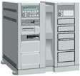


Architecture of Web-
based E-Commerce System
Service system
ackend syste
B
m
Web Server Application Server
Internet
Database
Firewall
Intranet (Secure)
Client side
Server side

Slide 18

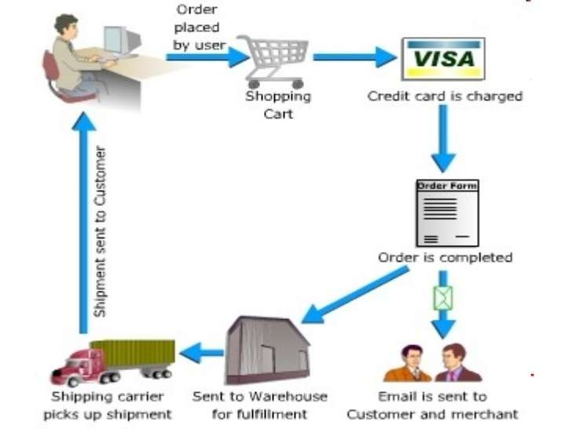
THE PROCESS OF E-COMMERCE

Slide 19

E-Commerce Categories
Two major categories
Other categories
3

Slide 20
Two Major Categories
Business-to-consumer (B2C) :
Online transactions are made between businesses and individual consumers. E.g. Amazon.com, eBay.com.
Business-to-business (B2B):
Businesses make online transactions with other businesses.

Slide 21
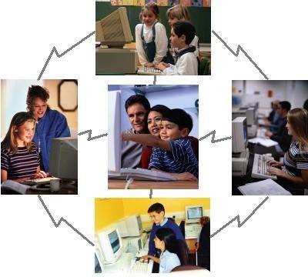
Other Categories
Consumer-to-consumer (C2C)
Mobile commerce (m-commerce)
4

Slide 22


Benefits of E-Commerce
Benefits to organizations
Benefits to consumers
5

Slide 23
Benefits to organizations
Global reach
Cost reduction
Extended hours: 24/7/365
Customization
Improved customer relations

Slide 24

Benefits to consumers
More products and services
Cheaper products and services
Instant delivery
Information availability

Slide 25

Business applications
Email
Instant messaging
Online shopping and order tracking
Online banking
Shopping cart software
Teleconferencing
Electronic tickets

Slide 26
Online Shopping
Online shopping is the process of buying goods and services from merchants who sell on the Internet
Online consumers are evenly split between men and women and tend to be better educated, younger, and more affluent than the general population

Slide 27

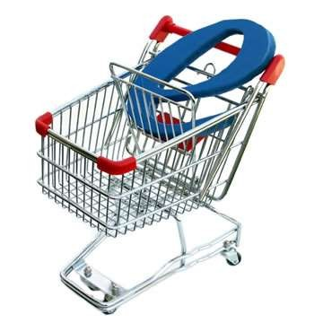
Online Shopping (cont)..
Advantages:
24-hour access
Ability to comparison shop
The in-home privacy
Variety
6

Slide 28
Online Shopping (cont)..
Favourite websites for shopping include those featuring:
Event tickets
Online periodicals subscription
Flowers and gifts
Consumer electronics
Travel

Slide 29
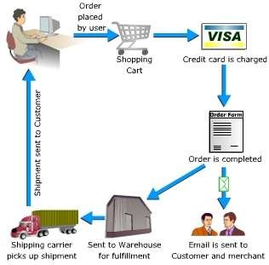
Online Shopping (cont)..
7
How do you buy something

Slide 30

Interesting Facts and Statistics
Every 1.2 seconds, a Canadian makes a purchase with their PayP₈al
account
In India it is 10 sec
Almost 20 per cent of Indians make three or more online
purchases per month (till 2014).
In future it must increases…………………….

Slide 31
Summary and Conclusion
The Internet has lead to the birth and evolution E- commerce. E-commerce has now become a key component of many organizations in the daily running of their business.
As the Internet and in turn E-commerce has developed, and continues to evolve and grow, it is vital that any organization, in any particular industry, must base its strategic planning around such a rapidly growing medium.

Slide 32

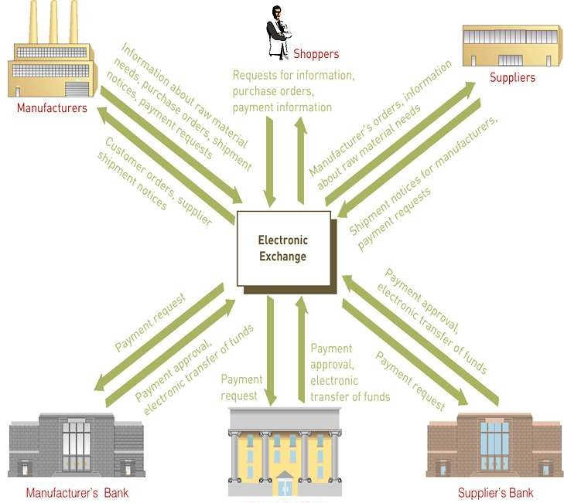
Model of an Electronic Exchange
Principles of Information Systems, Seventh Edition
32

Slide 33

















































Online Stores

Slide 34
Electronic Payment Systems (continued)
Electronic wallet: a computerized stored value that holds credit card information, electronic cash, owner identification, and address information
Credit card
Debit card
Smart card
Online banking and Cash On Delivery.
Principles of Information
Systems, Seventh Edition
34

Slide 35



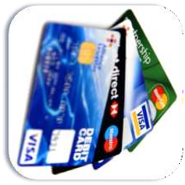
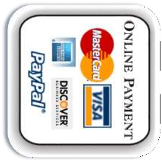
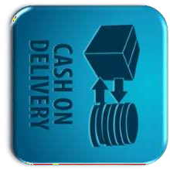
Services Offered

Slide 36
Thank You
☺
Are there any questions?

